Slide 1
Confounding Factors Effect on Guided Wave Ultrasonic Testing (GWUT)
Olisa C Samuel^{1*}, Khan A Muhammad¹ and Andrew Starr¹
¹School of Transport, Aerospace and Manufacturing, Cranfield University, Bedford MK43 0AL, UK; s.c.olisa@cranfield.ac.uk; muhammad.a.khan@cranfield.ac.uk

Slide 2
Abstract
Guided wave ultrasonic testing (GWUT) has attracted significant interest from industries and academia in search of smart technique for sensing and reliably determining the health state of structures. This technique offers a cost-effective approach and the potentials to inspect large coverage of structure at low frequency, energy attenuation and quick time. However, confounding factors on the acquired sensor signals pose a challenge in determining and characterizing some damage in structures. In this work, the state of confounding factors that affect structural health monitoring (SHM) is discussed, and future directions are envisioned for an in-suite monitoring and next-generation monitoring state.

Slide 3
1. Introduction
All structural materials are products of aggregated atoms held in their mean positions by a strong covalent bond to form different lattices.
Structural materials are essentially defined using their geometrical and mechanical properties. When these properties deviate from what they are ought to be, structural damage is inferred to have occurred[1,2].
Damage is an irreversible and progressive deterioration of materials from microscale through mesoscale to macroscale before being fractured or breakdown. Damage in structures could be any of the following crack, corrosion, dent, gouges or a combination of the mentioned.
Prominent among the methods used in inspecting structural materials is the guided wave ultrasonic testing (GWUT) method[3]. It is an effective method for structural health monitoring (SHM) that offers long-distance coverage on a test.
It uses Piezoelectric transducers that are lightweight and cost-effective to generate low-frequency Lamb waves of low energy attenuation.

Slide 4
2a. How SHM Works
In GWUT inspection, lamb waves are generated and received using either pulse-echo or pitch-catch configurations. The generated incident Lamb wave by the actuator, “speaker or mouth,” interacts with the host structure’s walls and be received by the sensor “listener or ear”. The distance between the actuator and the sensor is the inspecting area of the host structure. When the propagating Lamb wave encounters damage or special features of the host structure, it would be scattered, transmitted, attenuated, or converted to a different mode as the application case maybe [4][5]. The scattered reflected or transmitted Lamb waves are measured as waveform signal and be processed to investigate the existence of damage in the structure or determine the health condition of the host structure, as shown in Figure 1.

Slide 5
2b. How SHM Works
Figure 1: A typical Structural Health Monitoring (SHM) System.

Slide 6
3. Challenges
Lamb waves have an inherent challenge of multimode complexity that makes it challenging to identify the scattering or reflection caused by each feature in the structure at a given time and the same fate with the interpretation of the small scatter signal.
Recognising the damage scatter signal, especially the small scatter signal, helps to estimate and devise an appropriate maintenance or repair solution while the damage is still incubating.
Many researchers[3] have used a computational signal differential called residual signal to simplify damage wave scatter detection from the complex lamb wave. The residual signal is the supposed integrity signal that embodies the needed damage information. It is determined by subtracting the current measured wave signal from the referenced measured wave signal (undamaged and in good health conditions signal of the structure).
Although the computational residual signal is essential for high fidelity of damage detection, there still challenges when the GWUT system is deployed for SHM, damage detection and quantification in the actual application scenario.
In the field of application, the challenges are due to the influence effect of environmental and operational condition. These EOC factors affect the damage sensitivity of the SHM system, thereby leading to inaccuracy in damage detection and characterization. Some of these EOC factors are temperature, extra vibration and bonding nature between host structure and transducers. The computational residual technique is insufficient to discriminate between the changes caused by the factors and the damage especially when the damage is still at early stage of advancing.

Slide 7
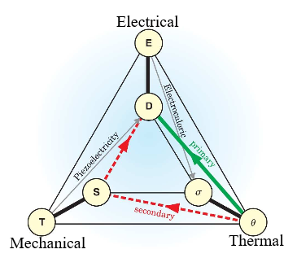
3. Cofounding Factors affecting PZT Lamb wave parameters
A. Temperature
Piezoelectric transducers are a family of pyroelectric devices that are primarily influenced or affected by temperature. The pyroelectric effect is the generation of electrical charge due to a change in temperature[6–8]. Primary pyroelectric effect, $P_{p}$is defined as the polarisation-temperature graph's slope at a given temperature as in equation (1).
$P_{p}=\frac{ΔP}{ΔT}$ ...................................................................................................... (1)
Figure 2: Primary and Secondary Pyroelectric contributions[6]

Slide 8
The PZT effect is a mutual coupling between electrical and mechanical variables in the PZT material. Hence, this effect is of two ways, as shown in Figure 3a below.
(i) One way is the direct piezoelectric effect that occurs when the PZT material is subjected to external stress that causes it to generate an electric charge proportional to the applied stress.
(ii)The second way is the inverse piezoelectric effect that generates mechanical energy when an electric field is applied and strain produced[12]. The strain so caused is proportional to the applied electric field. Hence, PZT transducers work in the mechanism of a proportional cause and effect. The properties of PZT materials can be described by equations 2, 3 and 4. It is equally captured in Figure 3b.
Figure 3a. Two ways PZT effect transformation

Slide 9
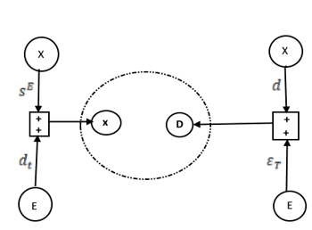
$\left(\begin{aligned}x \\ D\end{aligned}\right)=\left(\begin{matrix}s^{E} & ⅆ_{t} \\ d & ε_{T}\end{matrix}\right)\left(\begin{aligned}X \\ E\end{aligned}\right)$ ................................................................................... (2)
$x=s^{E}X+d_{t}E$ .............................................................................................. (3)
$D=dX+ε_{T}E$ ............................................................................................... (4)
Where$X=stress$ and $E=electric field$ that are independent variables
$x=mechanical strain and D=electric displacement$that are dependent variables.
$ε=$ Dielectric$; s=$ Elastic compliance ;$d=$piezoelectric constant. All the variables are tensors, and $t$ denotes a transposed tensor.
Figure 3b. The mutual coupling effect of PZT

Slide 10
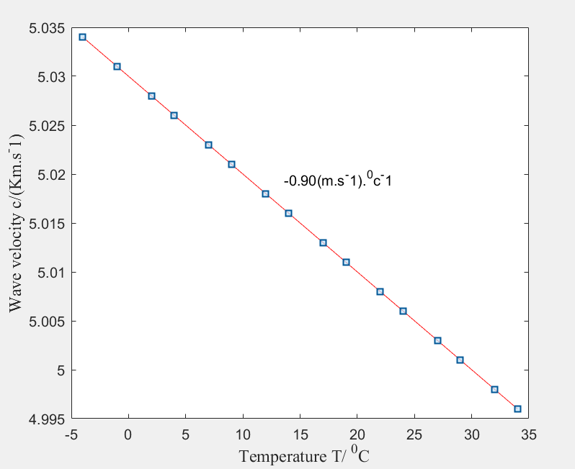
Temperature is a global factor that varies without a control. Its variation effect on the PZT Lamb wave has been studied numerically and experimentally[13–20]. It has been noted that temperature variations affect the parameters of the propagating Lamb, especially its amplitude and arriving time[14]. The temperature variation of as small as 0.5 ⁰C may cause a difference in the magnitude of the lamb wave[21].
In [22], the effect of the temperature range (−4 °C to 34 °C) on lamb wave, L (0,1) propagating on steel structure was investigated. The wave velocity linearly decreases as the temperature increase. As shown in Figure 4, the declining rate of the velocity was 0.9m/s for every degree increase in temperature.
Figure 4. Temperature effect on Lamb wave velocity (R) [22]

Slide 11
In [23], Lanza et al. studied the effect of temperature on the wave signal propagating on an anisotropic plate. It was observed that at a temperature below 20 ⁰C, the amplitude of the received wave signal increases while it decreases at a temperature above 20 ⁰C. This is stated in the piecewise equation function below. The study equally demonstrated that temperature variation does not affect the wavelength of the response signal rather its amplitude.
$f\left(y\right)=\left\{\begin{aligned}A^{+}, if T<20℃ \\ A^{−}, if T>20 ℃\end{aligned}\right.$ ……………………………. (5)
In[18], Raghavan and Cesnik studied the effect of varying temperature$(2℃−150 ℃$)on propagating guided wave.
It was observed that between 20 °C – 90 °C, the wave signal amplitude increases while between 90 °C - 150 °C,
the wave signal amplitude decreases. This is also stated in the piecewise equation function below.
$f\left(y\right)=\left\{\begin{aligned}A^{+}, if 90 °C<T≤150℃ \\ A^{−}, if 20 °C≤T<90℃\end{aligned}\right.$ …………………. (6)

Slide 12
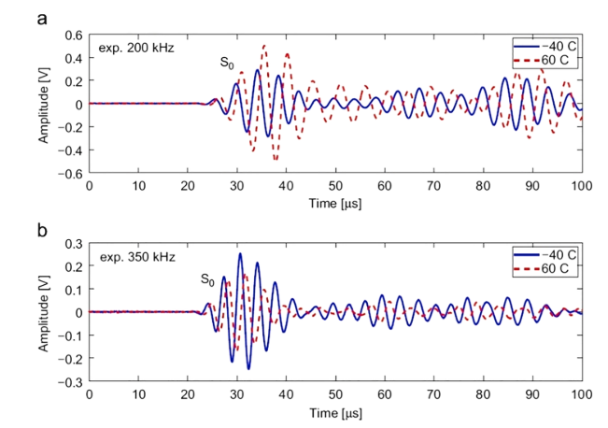
In[27], the authors observed that the amplitude for maximum system response occurred at an ambient temperature of 20 °C. They demonstrated that by increasing or decreasing the temperature, the system response is affected. They have also compared Lamb waves collected at two extreme temperatures, i.e. −40 °C and +60 °C, at the frequencies of 200KHz and 350 kHz in Figure 5a and 5b, respectively.
From Figure 5, it is deduced that at +60°C, Lamb wave presents a higher time-of-flight which signifies lesser propagation speed. It could be deduced from Figure 5 that signal at 200KHz has, on average, a higher amplitude, at 350 kHz, the opposite behaviour appears. The same result was obtained by Di Scalea et al in [23].
Figure 5: Experimental received Lamb waves at −40 °C and +60 °C at (a) 200KHz and (b) 350KHz[27].

Slide 13
From Figure 5, it is deduced that at +60°C, Lamb wave presents a higher time-of-flight which signifies lesser propagation speed. It could be deduced from Figure 5 that signal at 200KHz has, on average, a higher amplitude concerning at −40 °C, at 350 kHz, the opposite behaviour appears. The same result was obtained by Di Scalea et al in [23].
B. Vibration
Structures could experience vibrations other than the applied load during operation or its service life. The extra unplanned or unscheduled environmental forces acting on the structure could result in variation of the lamb wave parameters, leading to a false interpretation of the structure's health state or false alarm triggering.
In[11], the effect of vibration on propagating lamb wave was studied. The wave signals were measured in static and vibration conditions at a frequency value of 10Hz – 1000Hz under free-free boundary condition. The ToF of the two scenarios were observed to fluctuate and slightly differs at varying frequency. It was noted that the external vibration caused distortions in the time domain response signal but was compensated before ToF was deduced.

Slide 14
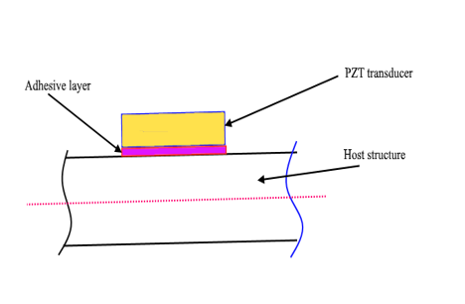
In [28], the authors studied the effect of random vibration, which is more like noise inclusion on lamb wave signals. They showed that random noise in the signal wave could compromise damage detection integrity by causing higher amplitude than expected. Such a situation resulted in clipping the signal, but it was sorted by using a high-pass filter. There is limited research work in extra vibration influence on the Lamb wave signal, especially concerning detecting various damage forms. Hence, more work is suggested to offer a cogent or multifaceted explanation of the impact of extra vibration in determining the orientation of damage and state health of structure in different application scenarios.
C. Adhesive and debonding effect.
The adhesive reagent is essential in SHM as it is used to integrate or bond Piezoelectric transducers on host structures. After applying the adhesive reagent on the PZT-Host surfaces, it can cure for hours. When cured, it bonds the PZT on the host structure and equally form a layer. Hence, the adhesive layer formed a couplant through which signal is transmitted from PZT to the host structure and from the host structure to PZT.
Figure 6: Bond-Structure interface

Slide 15
Studies have been done by researchers from low to high frequency in order to ascertain the effect of adhesive layer shear modulus and layer thickness[29–32].
In[32], the authors studied numerically the influence of adhesive layer on actuation of lamb wave using different range of frequencies. It was observed that the adhesive layer's thickness and the excitation frequency influence the amplitude of the sensor signal. Similarly, in [29] but experimentally, the authors performed the effect of adhesive thickness on lamb wave signals and frequency. They considered $10um$ and $40um$ adhesive layer thickness and used two sensors. They observed that at a lower frequency (i.e. 50KHz), the sensor with the smaller adhesive thickness had a stronger signal than the one with bigger adhesive thickness. However, as the frequency increased to 500KHz, the signal's amplitude from the sensor with small adhesive thickness became smaller when compared.

Slide 16
The existence of bonding defect is a challenge that could happen during the lifetime of the PZT-host structure.
This effect compromises the fidelity and the performance of GWUT used in SHM as it has an effect on its amplitude, modifies the signal phase and shape.
In[33] the effect of bonding defect compared the Lamb wave propagation in paths with equal distance through the same material but from transducers, with healthy and defective bonding as demonstrated. They have found that the effects of bonding defects on Lamb wave propagation are remarkable, modifying the phase, amplitude, and shape of propagated Lamb waves.

Slide 17
Conclusion
Monitoring the health state of structures is paramount to the economy and safety of the environment since structures are bound to fail, and their failure could cause economic and safety challenges.
The awareness and use of GWUT for SHM has gained enormous interest in academia and industries. The lightweight nature, low energy attenuation, low-frequency operations and long-distance coverage properties have made GWUT a good choice. Many studies have shown that some factors such as the temperature of environmental operation, the adhesive layer thickness and bond defect have consequential effect or influence on the parameters of the guided wave, such as its amplitude and ToF.
Various experimental and numerical studies regarding the impact of temperature variation on Lamb wave showed that it is not linear. This is because temperature variation could cause expansion and contraction of the structure, thereby varying the distance between the permanently installed actuator-sensor, which would affect the ToF of the wave. Variation of temperature could also cause changes in the stiffness of the host structure to decrease variation in moduli as temperature increases which has a decreasing effect on the wave velocity.
Also, the temperature rise could affect the adhesive layer property and influence the fidelity of signal transmission between the transducer and the host structure. The bond defect affects the coupling impedance between the transducer and the host structure, affecting the signal amplitude, shape, and phase.
The thickness of the adhesive layer also influences the signal amplitude. Still, this effect is more negligible at the resonant of the PZT, thereby allowing high fidelity of signal transmission between the PZT and the structure.
Many compensation techniques have been developed to handle the effect of temperature variation on the guided wave[34][35]. Most of these compensation techniques were developed in isolation of some of these factors; hence a compensation technique that accommodates all other aspects should be developed.
Also, there is no explicit standard on the type of adhesive reagent and thickness of the adhesive layer to be used during transducer-host structure integration. Hence, a guide needs to be established since all these factors mentioned above can affect the integrity and fidelity of the inspecting wave; then, an overhaul technique that would differentiate the effect caused by the cofounding factors from that of the damage on the guided wave needs to be developed.

Slide 18
APPRECIATION
THANK YOU
FOR
LISTENING

Slide 19
References
[1] M. Abbas, M. Shafiee, Structural health monitoring (SHM) and determination of surface defects in large metallic structures using ultrasonic guided waves, Sensors (Switzerland). 18 (2018). https://doi.org/10.3390/s18113958.
[2] B. Zima, R. Kędra, Detection and size estimation of crack in plate based on guided wave propagation, Mechanical Systems and Signal Processing. 142 (2020). https://doi.org/10.1016/j.ymssp.2020.106788.
[3] S.C. Olisa, M. A. Khan, A. Starr, Review of Current Guided Wave Ultrasonic Testing (GWUT) Limitations and Future Directions, Sensors (Switzerland). 21 (2021). https://doi.org/10.1057/9781137353238_7.
[4] G. Wang, Y. Wang, H. Sun, B. Miao, Y. Wang, A Reference Matching-Based Temperature Guided Wave Signals, Sensor. (2019).
[5] S. Mariani, P. Cawley, Change detection using the generalized likelihood ratio method to improve the sensitivity of guided wave structural health monitoring systems, Structural Health Monitoring. (2020). https://doi.org/10.1177/1475921720981831.
[6] S.B. Lang, Pyroelectricity : From ancient curiosity to modern imaging tool Pyroelectricity, Physics Today. 58 (2005) 31.
[7] R.W. Whatmore, Pyroelectric devices and materials, Reports on Progress in Physics. 49 (1986) 1335–1386. https://doi.org/10.1088/0034-4885/49/12/002.
[8] V. Ming Hong Ng, L. Bing Kong, W. Que, C. Wang, S. Li, T. Zhang, Pyroelectric Materials, Comprehensive Energy Systems. 2–5 (2018) 720–759. https://doi.org/10.1016/B978-0-12-809597-3.00249-2.

Slide 20
[9] C.H. Hong, H.P. Kim, B.Y. Choi, H.S. Han, J.S. Son, C.W. Ahn, W. Jo, Lead-free piezoceramics – Where to move on?, Journal of Materiomics. 2 (2016) 1–24. https://doi.org/10.1016/j.jmat.2015.12.002.
[10] R. Manwar, K. Kratkiewicz, K. Avanaki, Overview of ultrasound detection technologies for photoacoustic imaging, Micromachines. 11 (2020) 1–24. https://doi.org/10.3390/mi11070692.
[11] X. Lu, C.K. Soh, P.V. Avvari, Lamb wave propagation in vibrating structures for effective health monitoring, Health Monitoring of Structural and Biological Systems 2015. 9438 (2015) 94381Z. https://doi.org/10.1117/12.2083931.
[12] P. Jiao, K.J.I. Egbe, Y. Xie, A.M. Nazar, A.H. Alavi, Piezoelectric sensing techniques in structural health monitoring: A state-of-the-art review, Sensors (Switzerland). 20 (2020) 1–21. https://doi.org/10.3390/s20133730.
[13] B.F. Stephen, P.. Jr, Effect of temperature on ultrasonic velocity in steel, in: Corrosion 97, New Orleans, LA (United States), 1997.
[14] P. Van Thanh, P. Thi Tuyet Nhung, L. Thi Minh Thuy, N. Hoa Nhai, Effect of Temperature on Ultrasonic Velocities, Attenuations, Reflection and Transmission Coefficients between Motor Oil and Carbon Steel Estimated by Pulse-echo Technique of Ultrasonic Testing Method, VNU Journal of Science: Mathematics-Physics. 31 (2015) 39–48. http://repository.vnu.edu.vn/bitstream/VNU_123/55799/1/43.pdf.
[15] X. Yan, L. Qiu, S. Yuan, Experimental study of guided waves propagation characteristics under the changing temperatures, in: Vibroengineering Procedia, 2018: pp. 208–212. https://doi.org/10.21595/vp.2018.20262.
[16] L.I.U. Zenghua, Z. Jichen, W.U. Bin, H.E. Cunfu, Temperature Dependence of Ultrasonic Longitudinal Guided Wave Propagation in Long Range Steel Strands, Chinese Journal of Mechanical Engineering. 24 (2011). https://doi.org/10.3901/CJME.2011.03.487.
[17] F. Lanza di Scalea, S. Salamone, Temperature effects in ultrasonic Lamb wave structural health monitoring systems, Acoustical Society of America. (2017) 161–174. https://doi.org/10.1121/1.2932071.
[18] A. Raghavan, C.E.S. Cesnik, Studies on effects of elevated temperature for guided-wave structural health monitoring, Sensors and Smart Structures Technologies for Civil, Mechanical, and Aerospace Systems 2007. 6529 (2007) 65290A. https://doi.org/10.1117/12.715016.

Slide 21
[19] A. Raghavan, C.E. Cesnik, Studies on effects of elevated temperature for guided-wave structural health monitoring, Sensors and Smart Structures Technologies for Civil, Mechanical, and Aerospace Systems. (2020). https://doi.org/10.1117/12.715016.
[20] Y. Lu, J.E. Michaels, A methodology for structural health monitoring with diffuse ultrasonic waves in the presence of temperature variations, Ultrasonics. 43 (2005) 717–731. https://doi.org/10.1016/j.ultras.2005.05.001.
[21] R. Radecki, W.J. Staszewski, T. Uhl, Impact of changing temperature on lamb wave propagation for damage detection, Key Engineering Materials. 588 (2014) 140–148. https://doi.org/10.4028/www.scientific.net/KEM.588.140.
[22] Z. Liu, J. Zhao, B. Wu, C. He, Temperature dependence of ultrasonic longitudinal guided wave propagation in long range steel strands, Chinese Journal of Mechanical Engineering (English Edition). 24 (2011) 487–494. https://doi.org/10.3901/CJME.2011.03.487.
[23] F. Lanza di Scalea, S. Salamone, Temperature effects in ultrasonic Lamb wave structural health monitoring systems, The Journal of the Acoustical Society of America. 124 (2008) 161–174. https://doi.org/10.1121/1.2932071.
[24] A. Dhutti, T.H. Gan, W. Balachandran, J. Kanfoud, High temperature performance of ultrasonic guided wave system for structural health monitoring of pipeline, Proceedings of the 7th Asia-Pacific Workshop on Structural Health Monitoring, APWSHM 2018. (2018) 308–316.
[25] B.C. Lee, G. Manson, W.J. Staszewski, Environmental Effect on Lamb Wave Responses from Piezoceramic sensors, Material Science Forum. 440–441 (2003) 195–202.
[26] G. Konstantinidis, B.W. Drinkwater, P.D. Wilcox, The temperature stability of guided wave structural health monitoring systems, Smart Materials and Structures. 15 (2006) 967–976. https://doi.org/10.1088/0964-1726/15/4/010.
[27] A. Marzani, S. Salamone, Numerical prediction and experimental verification of temperature effect on plate waves generated and received by piezoceramic sensors, Mechanical Systems and Signal Processing. 30 (2012) 204–217. https://doi.org/10.1016/j.ymssp.2011.11.003.

Slide 22
[28] M. Salmanpour, Z. Sharif Khodaei, M.H. Aliabadi, Damage detection with ultrasonic guided wave under operational conditions, 9th European Workshop on Structural Health Monitoring, EWSHM 2018. (2018).
[29] X.P. Qing, H.L. Chan, S.J. Beard, T.K. Ooi, S.A. Marotta, Effect of adhesive on the performance of piezoelectric elements used to monitor structural health, International Journal of Adhesion and Adhesives. 26 (2006) 622–628. https://doi.org/10.1016/j.ijadhadh.2005.10.002.
[30] O. Rabinovitch, J.R. Vinson, Adhesive layer effects in surface-mounted piezoelectric actuators, Journal of Intelligent Material Systems and Structures. 13 (2002) 689–704. https://doi.org/10.1177/1045389X02013011001.
[31] K.R. Mulligan, N. Quaegebeur, P. Masson, L.P. Brault, C. Yang, Compensation of piezoceramic bonding layer degradation for structural health monitoring, Structural Health Monitoring. 13 (2014) 68–81. https://doi.org/10.1177/1475921713500516.
[32] Z. Sharif Khodaei, L. Qu, M.H. Aliabadi, Influence of adhesive layer on actuation of lamb wave signals, Key Engineering Materials. 525–526 (2012) 617–620. https://doi.org/10.4028/www.scientific.net/KEM.525-526.617.
[33] G. Park, C.R. Farrar, F.L. Di Scalea, S. Coccia, Performance assessment and validation of piezoelectric active-sensors in structural health monitoring, Smart Materials and Structures. 15 (2006) 1673–1683. https://doi.org/10.1088/0964-1726/15/6/020.
[34] N. Yue, M.H. Aliabadi, A Scalable Temperature Compensation Method for Guided Wave Based Structural Health Monitoring of Anisotropic CFRP Structures, Lecture Notes in Civil Engineering. 128 (2021) 539–549. https://doi.org/10.1007/978-3-030-64908-1_50.
[35] S. Mariani, S. Heinlein, P. Cawley, Compensation for temperature-dependent phase and velocity of guided wave signals in baseline subtraction for structural health monitoring, Structural Health Monitoring. 19 (2020) 26–47. https://doi.org/10.1177/1475921719835155.

